Slide 1

Blight Tickets Henrique Issamu Umeda - 2021

Slide 2
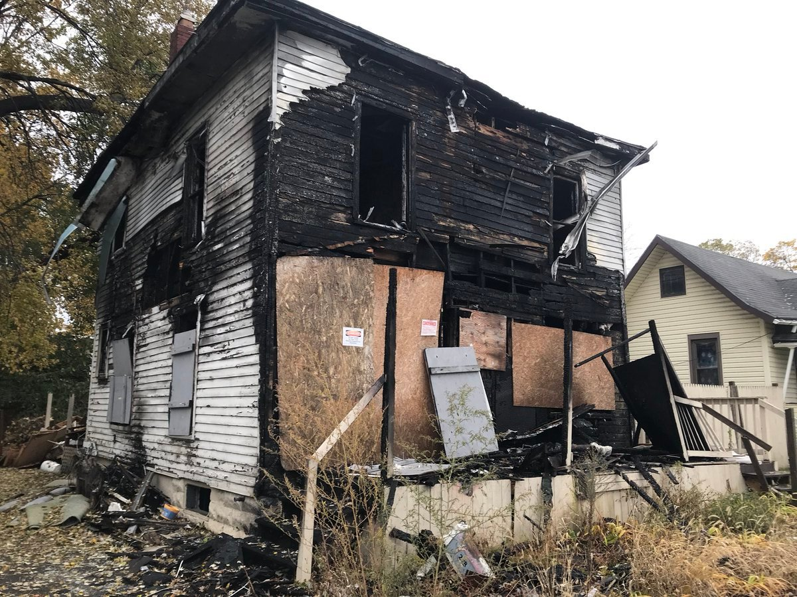

City of Detroit
Blight violations:
Properties remain in a deteriorated condition
Millions of dollars issued in fines (blight ticket)
Most blight tickets remain unpaid

Slide 3
Blight Tickets
2005
2006
2007
2008
2009
2010
2011
I: $ 5,191,939.00
I: $ 7,626,712.00
I: $ 7,424,822.50
I: $ 7,084,717.50
I: $ 5,178,177.50
I: $ 2,693,192.50
I: $ 1,999,270.00
CR: 7.61%
CR: 7.23%
CR: 7.07%
CR: 6.49%
CR: 7.37%
CR: 4.56%
CR: 7.92%
P: $ 1,257,011.40
P: $ 1,220,407.70
P: $ 841,527.10
P: $ 958,752.60
P: $ 653,526.60
P: $ 331,778.30
P: $ 259,631.90
PP: 24.21%
PP: 16.00%
PP: 11.33%
PP: 13.53%
PP: 12.62%
PP: 12.32%
PP: 12.99%
I: Issued amount
P: Paid amount
PP: Paid Percentage
CR: Compliance Ratio (ticket paid on time or within one month of the hearing date)

Slide 4
Blight Tickets
Tickets
Compliance
Paid Amount
Pending Payment
Quantity: 96,745
Amount: $ 37,206,316.00
Quantity: 6,740
Ratio: 7%
Amount: $ 5,523,768.70
Ratio: 14.85%
Amount: $ 31,682,555.40
Ratio: 85.15%

Slide 5
Objectives
1
2
3
Predict whether a blight ticket will be compliant
Predict whether a non-compliant blight ticket will be paid
Increase the amount received from non-compliant tickets

Slide 6
1 Predict whether a blight ticket will be compliant

Slide 7
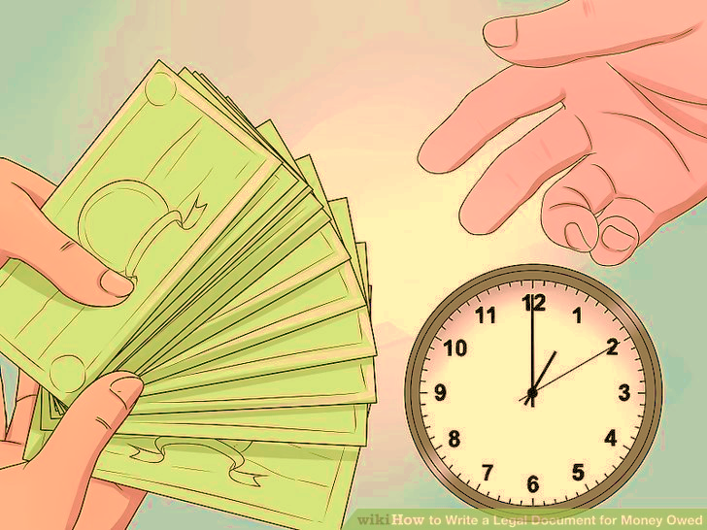
Owed Amount

Slide 8
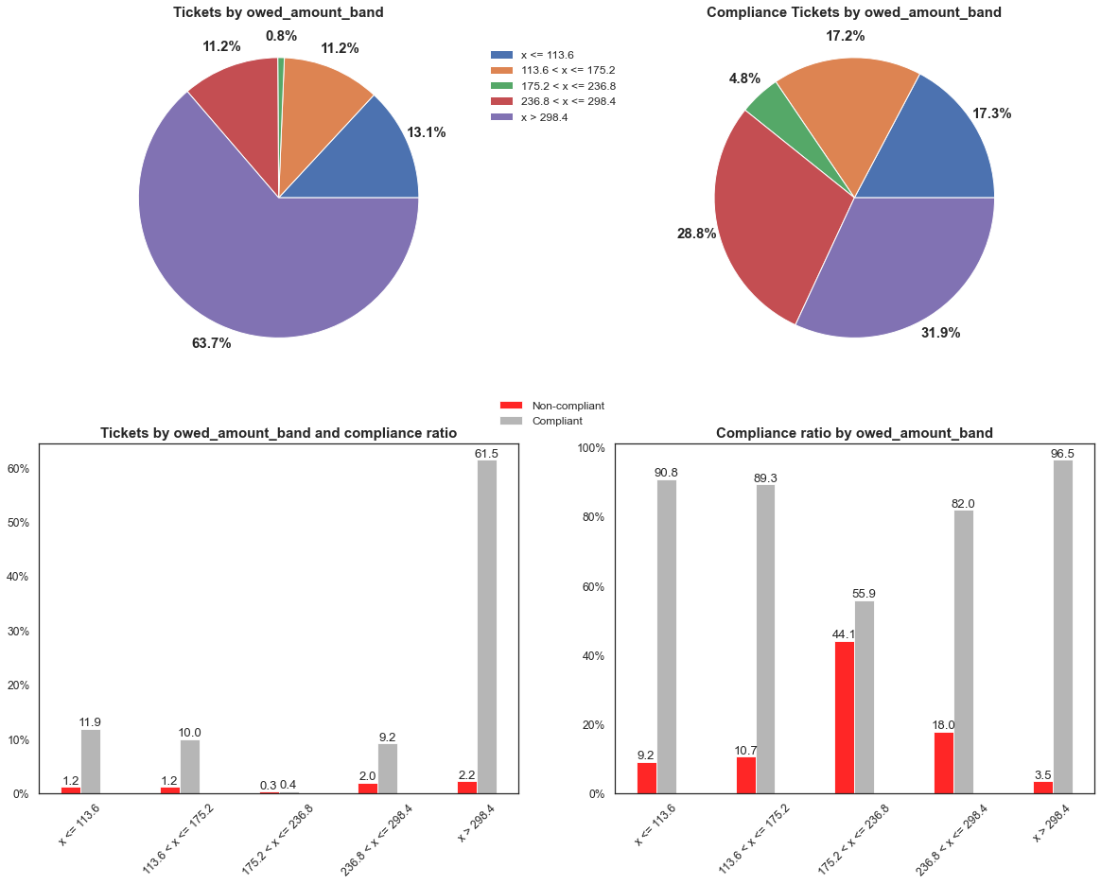

Slide 9

Agency

Slide 10
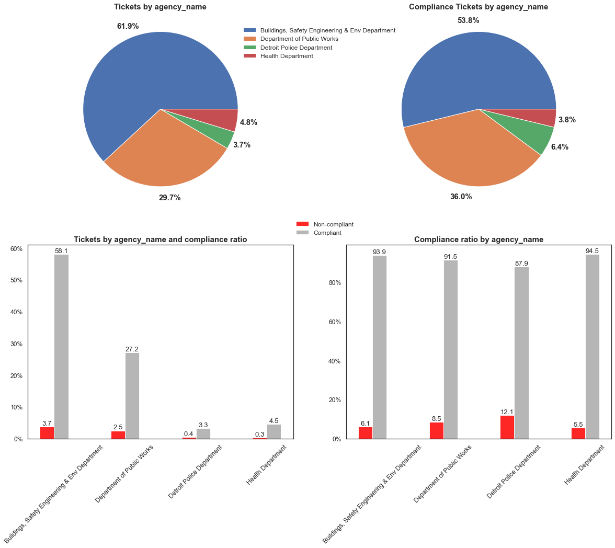

Slide 11

Disposition (Judgement Type)

Slide 12
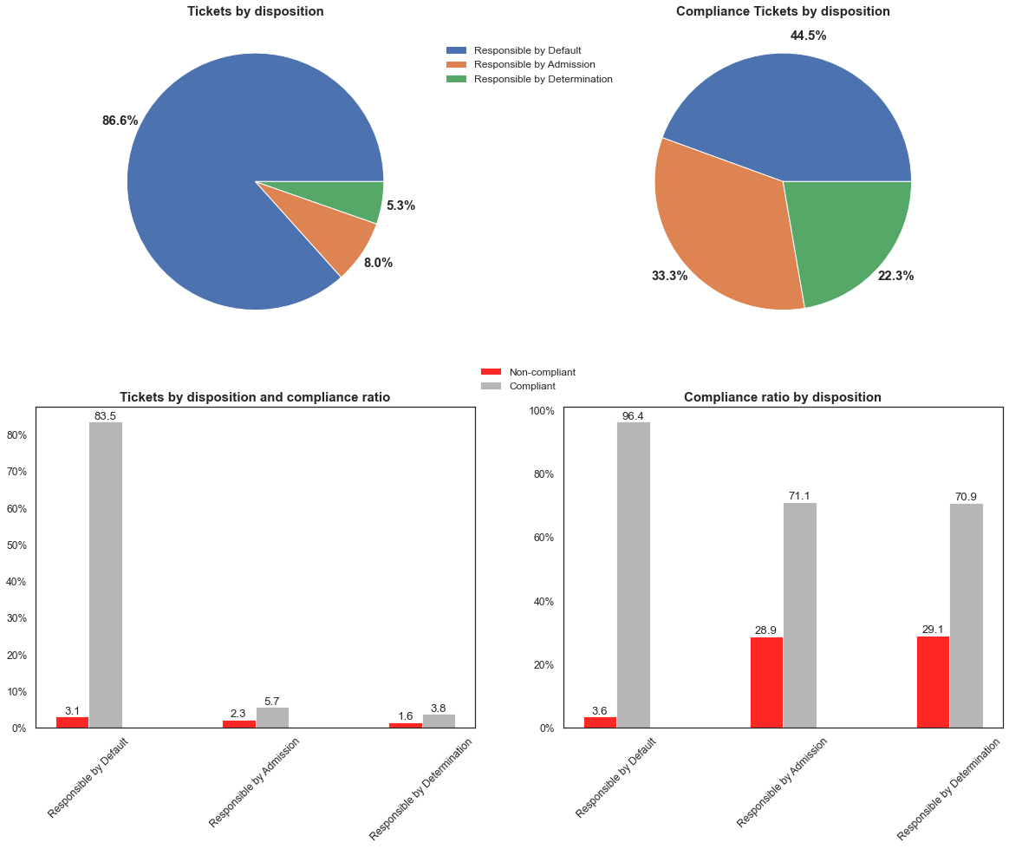

Slide 13

Ticket Issue Semester

Slide 14
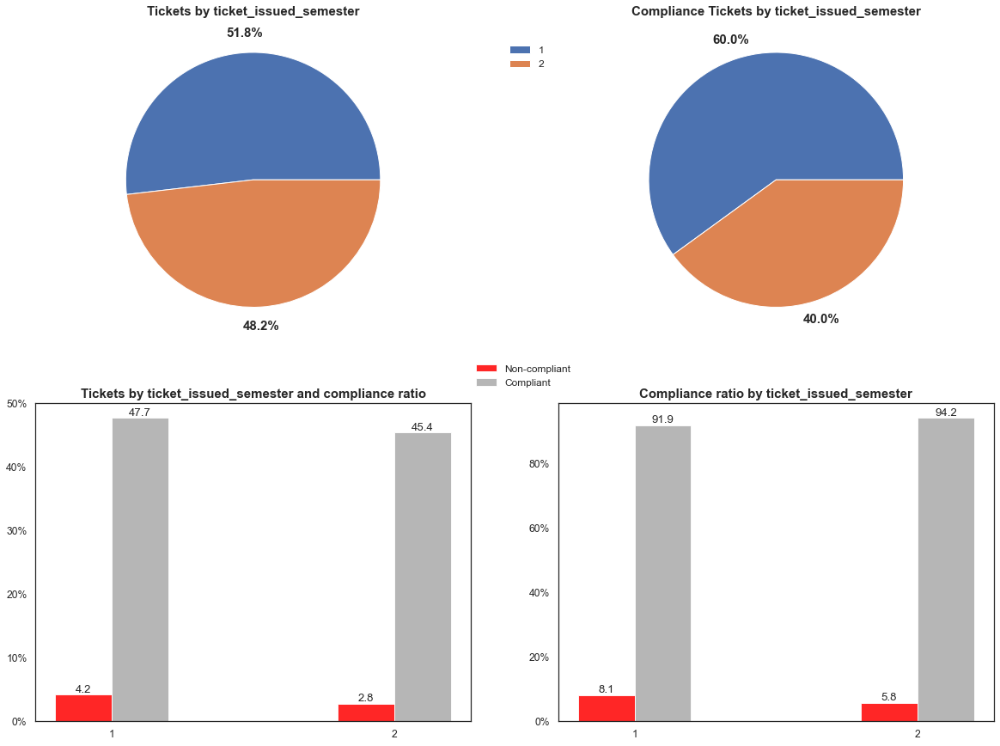

Slide 15


Slide 16
Violation Code | Compliance
22-2-61 | 24.22%
61-81.0100/32.0066 | 15.96%
9-1-103(C) | 12.90%
22-2-43 | 12.44%
22-2-45 | 12.21%
… | …
9-1-81(a) | 3.03%
9-1-82(d) - (Dwellin | 2.26%
19450901 | 2.15%
22-2-83(a)(b)(c) | 1.96%
9-1-43(a) - (Dwellin | 1.55%

Slide 17

Compliance Prediction

Slide 18
Main Characteristics
Feature | Tickets | Non-Compliant Tickets | Compliant Tickets
Number of Residents | 96,745 | 90,005 | 6,740
Agency | Buildings, Safety Engineering & Env Dep. (59,860 (61.9%)) | Buildings, Safety Engineering & Env Dep. (56,233 (62.5%)) | Buildings, Safety Engineering & Env Dep. (3,627 (53.8%))
Violation Code | 9-1-36(a) (41,242 (42.6%)) | 9-1-36(a) (38,226 (42.5%)) | 9-1-36(a) (3,016 (44.7%))
Judgment Type | Responsible by Default (83,817 (86.6%)) | Responsible by Default (80,821 (89.8%)) | Responsible by Default (2,996 (44.5%))
Owed Amount | $ 37,206,316.00 | $ 35,474,094.50 | $ 1,732,221.50
Payment | $ 5,523,768.70 (14.9%) | $ 3,884,351.40 (11.0%) | $ 1,639,417.30 (94.6%)

Slide 19
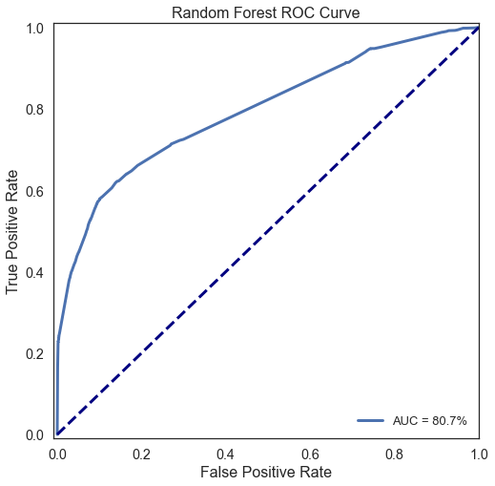
Compliance Prediction Model

Slide 20
2 Predict whether a non-compliant blight ticket will be paid

Slide 21
Owed Amount

Slide 22
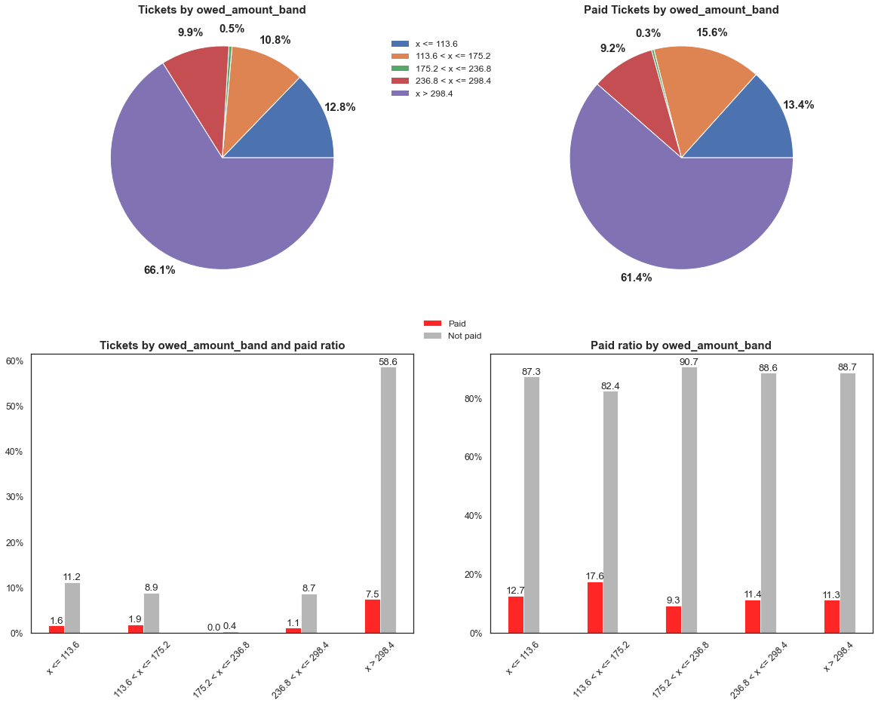

Slide 23
Agency

Slide 24
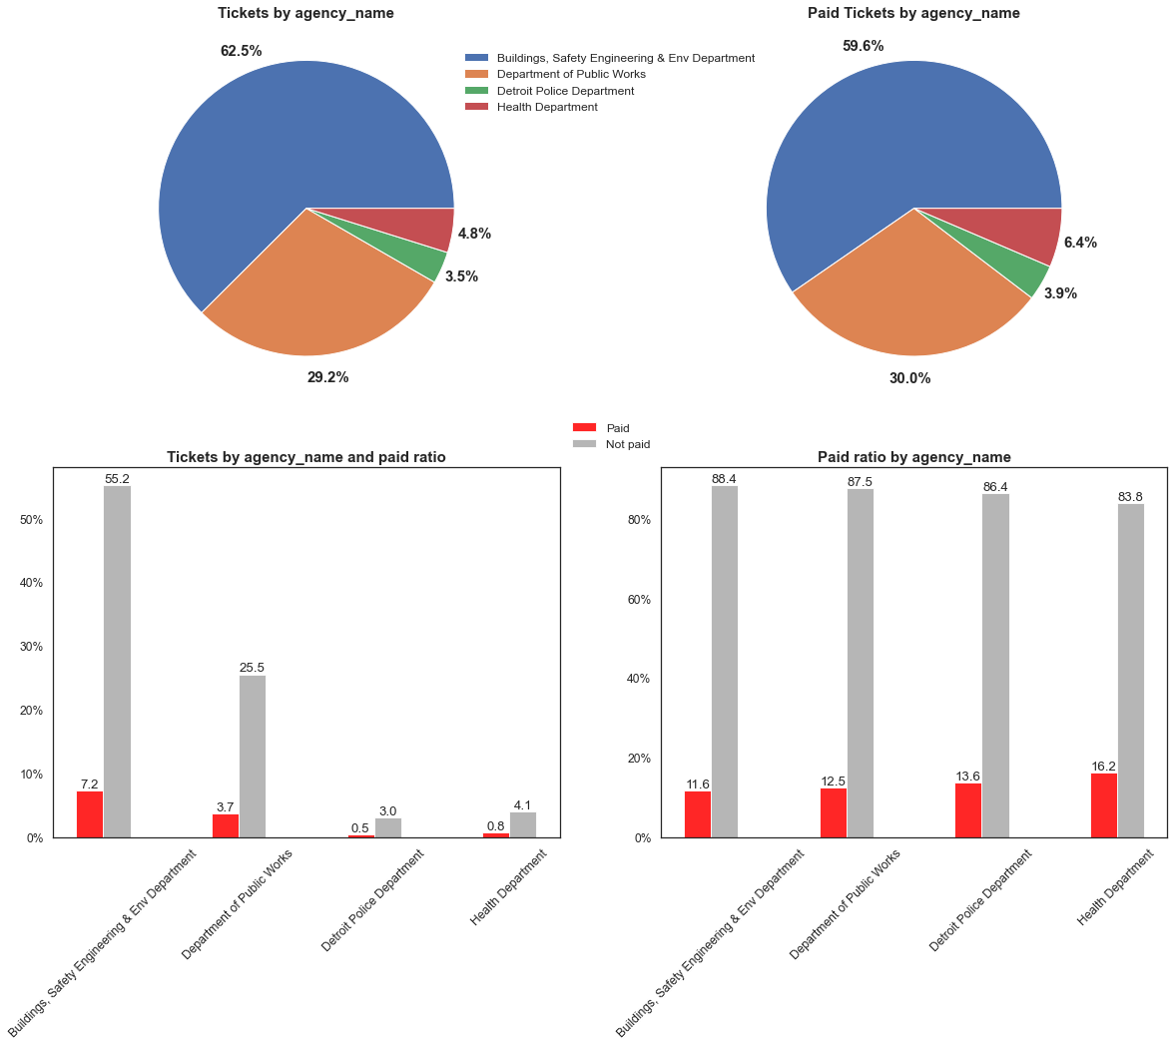

Slide 25
Disposition (Judgement Type)

Slide 26
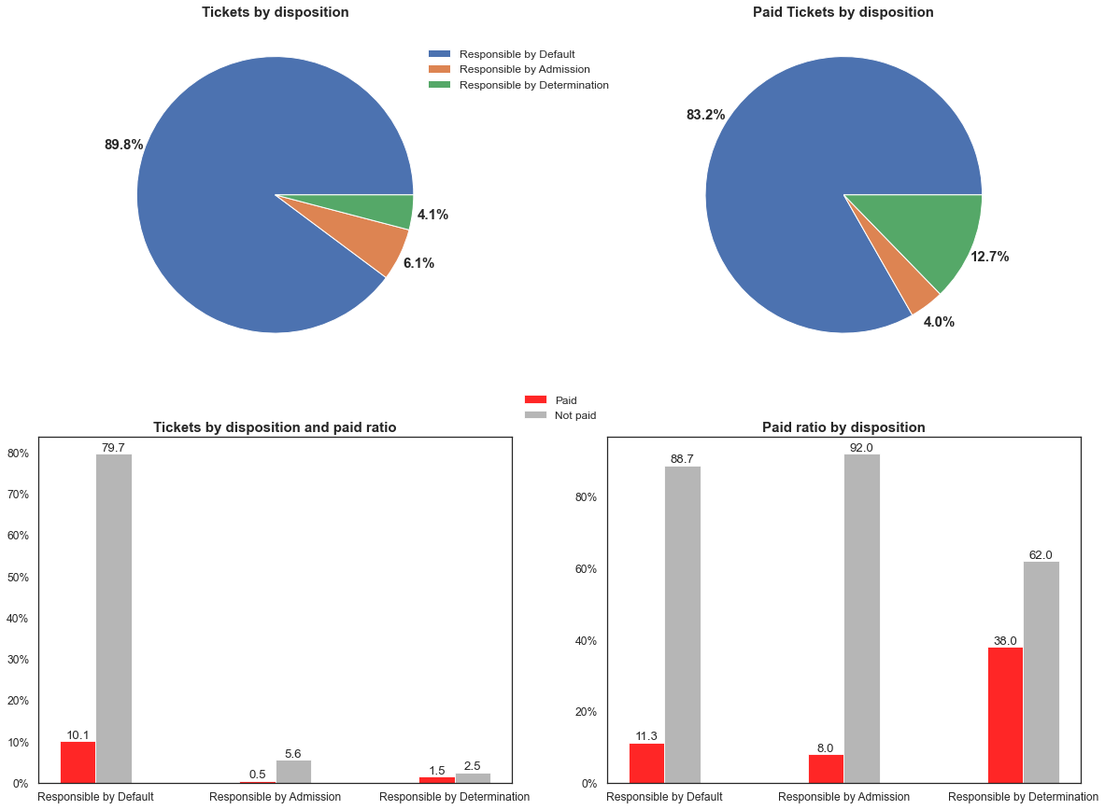

Slide 27
Ticket Issue Semester

Slide 28
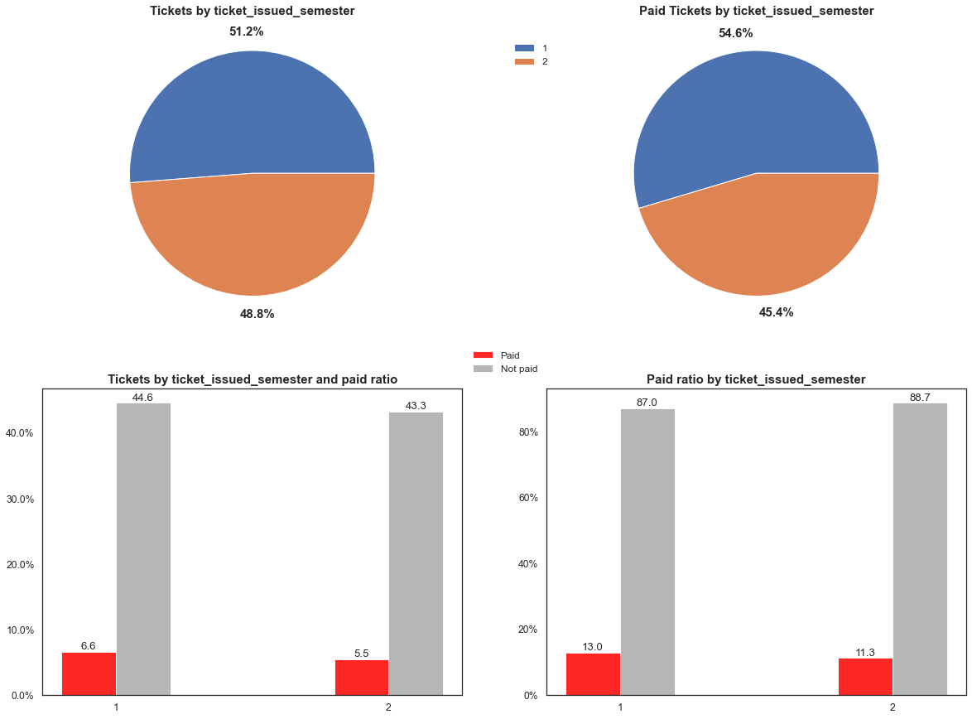

Slide 29

Ticket Issue Year

Slide 30
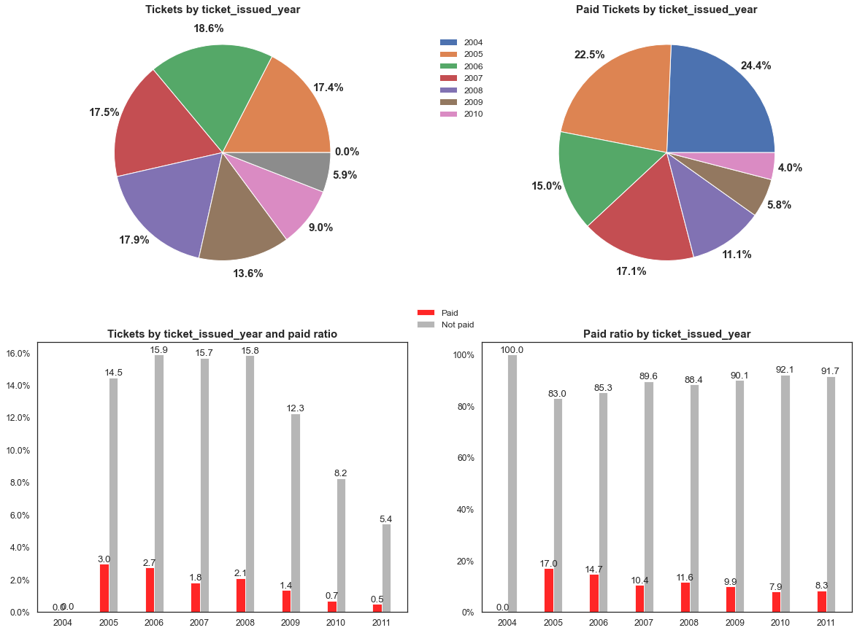

Slide 31
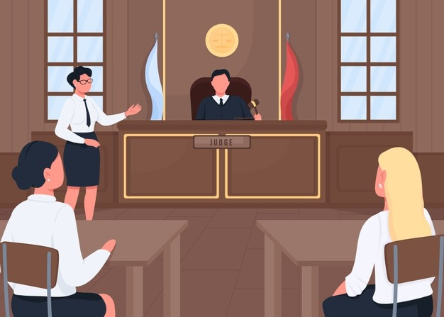
Hearing Year

Slide 32
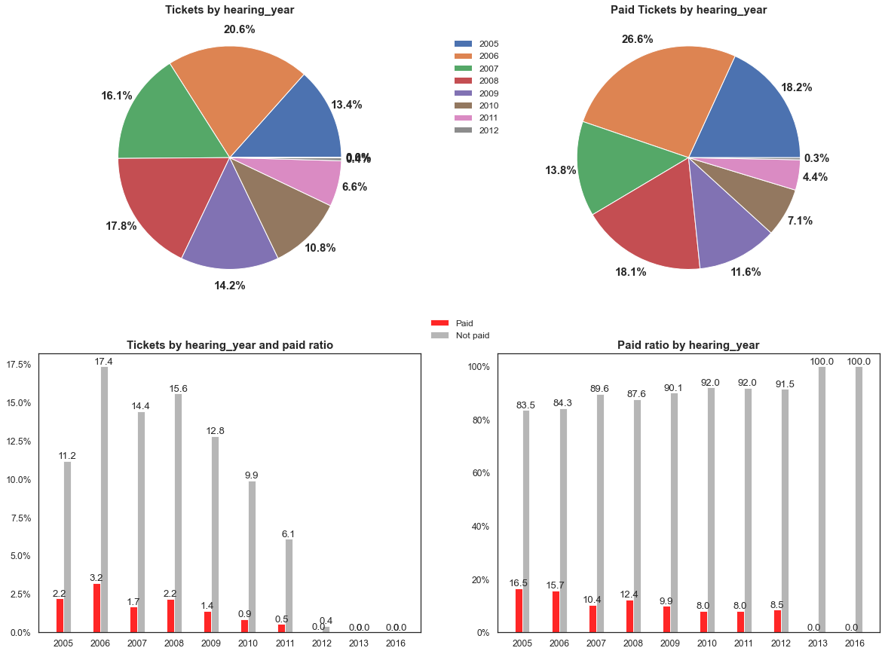

Slide 33


Slide 34
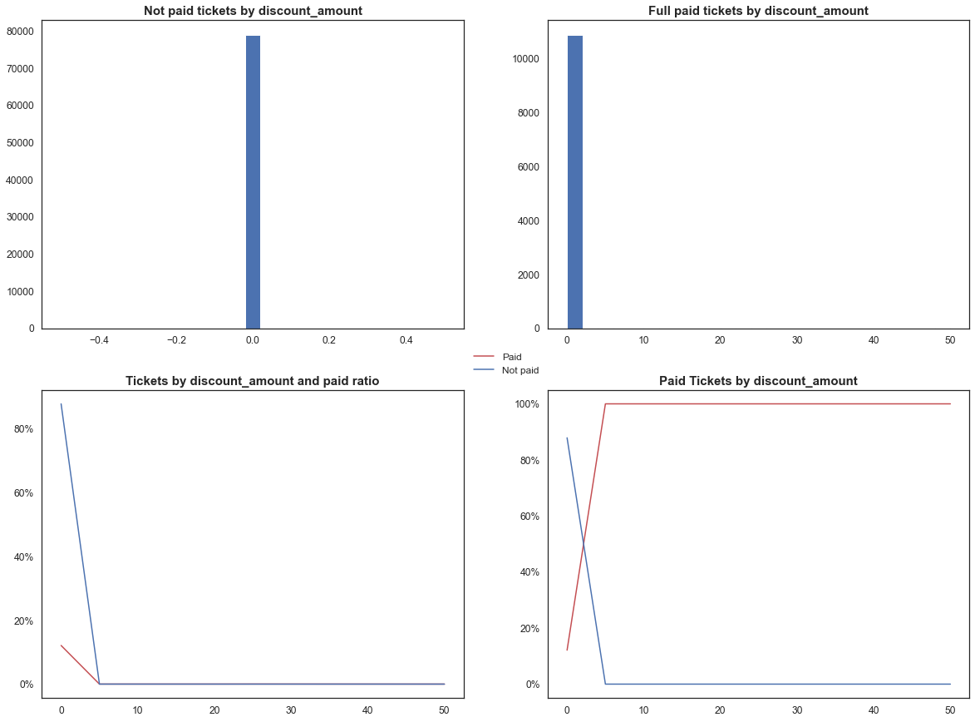

Slide 35

Non-Compliant Payment Prediction

Slide 36
Main Characteristics
Feature | Tickets | Pending Payment Tickets | Full Paid Tickets
Number of Tickets | 90,005 | 79,062 | 10,943
Agency | Buildings, Safety Engineering & Env Dep. (56,233 (62.5%)) | Buildings, Safety Engineering & Env Dep. (49,709 (62.9%)) | Buildings, Safety Engineering & Env Dep. (6,524 (59.6%))
Judgment Type | Responsible by Default (80,821 (89.8%)) | Responsible by Default (71,711 (90.7%)) | Responsible by Default (9,110 (83.2%))
Discount Amount | $ 855.00 | $ 0.00 | $ 855.00
Owed Amount | $ 35,474,094.50 | $ 32,198,375.00 | $ 3,275,719.50
Payment | $ 3,884,351.40 (11.0%) | $ 987,757.60 (3.1%) | $ 2,896,893.80 (88.4%)

Slide 37
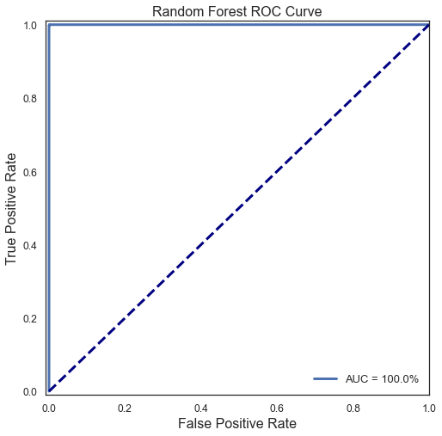
Payment Prediction Model

Slide 38
Predictions
Feature | Tickets | Pending Payment Tickets | Full Paid Tickets
Number of Tickets | 90,005 | 79,062 | 10,943
Discount Amount | $ 855.00 | $ 0.00 | $ 855.00
Owed Amount | $ 35,474,094.50 | $ 32,198,375.00 | $ 3,275,719.50
Paid Amount | $ 3,884,351.40 | $ 987,757.60 | $ 2,896,893.80
Payment Prediction | $ 378,082.77 | $ 10,119.52 | $ 367,963.25
Paid Amount After Prediction | $ 4,262,434.17 | $ 997,877.12 | $ 3,264,557.05
Pending Amount | $ 31,212,515.33 | $ 31,200,497.88 | $ 12,017.45

Slide 39
3 Increase the amount received from non-compliant tickets

Slide 40

Solution
Discounts according to the chance of payment predicted
Payment Probability | Discount
p >= 80% | 0%
50% <= p < 80% | 20%
30% <= p < 50% | 50%
10% <= p < 30% | 60%
5% <= p < 10% | 75%
p < 5% | 90%

Slide 41
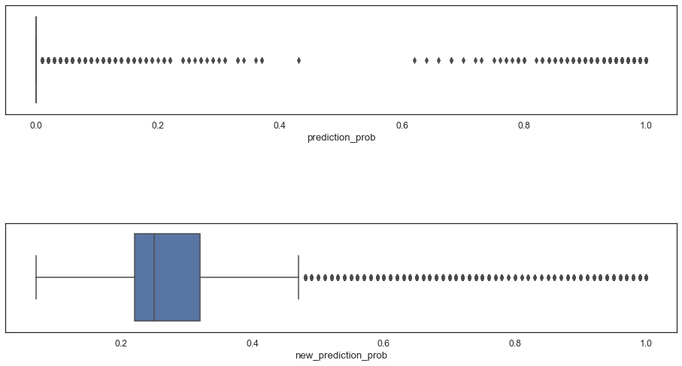
Payment Probability Distribution

Slide 42
New Predictions
Feature | Tickets | Pending Payment Tickets | Full Paid Tickets
Number of Tickets | 90,005 | 79,062 | 10,943
Discount Amount | $ 28,078,009.15 | $ 28,075,170.65 | $ 2,838.50
Owed Amount | $ 7,396,940.45 | $ 4,123,204.45 | $ 3,273,736.00
Paid Amount | $ 3,884,351.40 | $ 987,757.60 | $ 2,896,893.80
Payment Prediction | $ 1,038,732.22 | $ 673,266.36 | $ 365,505.86
Paid Amount After Prediction | $ 4,923,083.62 | $ 1,660,983.96 | $ 3,262,099.66
Pending Amount | $ 2,473,856.83 | $ 2,462,220.49 | $ 11,636.64

Slide 43
Solution Profit Estimations
Feature | No Discount | With Discount | Change
Owed Amount | $ 35,474,094.50 | $ 7,396,940.45 | - 79.1%
Discount Amount | $ 855.00 | $ 28,078,009.05 | + 3,283,877.7%
Paid Amount | $ 3,884,351.40 | $ 3,884,351.40 | -
Payment Prediction | $ 378,082.77 | $ 1,038,732.22 | + 174.7%
Paid Amount After Prediction | $ 4,262,434.17 | $ 4,923,083.62 | + 15.5%
Pending Amount | $ 31,212,515.33 | $ 2,473,856.83 | - 92.1%
Pending Percentage | 88.0% | 33.4% | - 54.6%

Slide 44


Slide 45
Next Steps
Compliance Model
Compliance
Discount Solution
Improve the accuracy of the compliance prediction method
Elaborate new strategies to avoid future default blight tickets
Create a method that optimizes the discount percentage choice to maximize the receipt and minimize the pending payment percentage

Slide 46



Henrique Issamu Umeda issamuumeda@gmail.com /henriqueissamu /henriqueumeda

